Slide 1
COMPUTER PARTS NAME
Cabinet, Motherboard, Processor, Memory, Storage & Peripherals – Explained in Detail

Slide 2
Computer Parts Name
FROM THE ORIGINAL SLIDE
IN SHORT
CABINET BOX WITH SMPS
MOTHER BOARD
MICROPROCESSOR
HARD DISK
RAM
DVD /WRITER
MONITOR
KEYBOARD
MOUSE
Cabinet box with SMPS – Case + power supply
MOTHER BOARD – Main circuit board
MICROPROCESSOR – CPU – the brain
HARD DISK – Permanent storage
RAM – Temporary memory
DVD /WRITER – Reads/writes discs
MONITOR – Output display
KEYBOARD – Input – typing
MOUSE – Input – pointing
A computer is made of hardware parts. Internal parts sit inside the cabinet; the monitor, keyboard and mouse are connected outside.

Slide 3
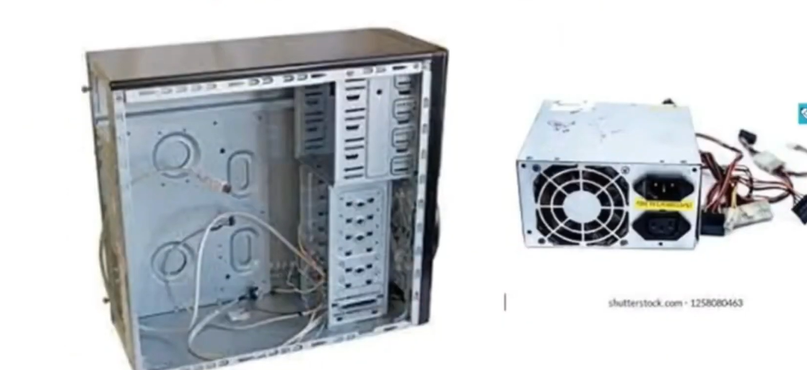
Cabinet Box with SMPS
IN DETAIL
The cabinet (case) is the metal box that holds and protects all internal parts and keeps them in position with screws and drive bays.
SMPS (Switched Mode Power Supply) is the metal box with a fan at the back. It converts 220 V AC from the wall socket into low-voltage DC (12 V, 5 V, 3.3 V) needed by the motherboard, hard disk and drives.
Its many coloured wires end in connectors for the motherboard (ATX), hard disk (SATA/Molex) and CPU fan.
The fan inside keeps the SMPS cool; the two sockets at the back are for power input.
Notes:
The cabinet (case) is the metal box that holds and protects all internal parts and keeps them in position with screws and drive bays.
SMPS (Switched Mode Power Supply) is the metal box with a fan at the back. It converts 220 V AC from the wall socket into low-voltage DC (12 V, 5 V, 3.3 V) needed by the motherboard, hard disk and drives.
Its many coloured wires end in connectors for the motherboard (ATX), hard disk (SATA/Molex) and CPU fan.
The fan inside keeps the SMPS cool; the two sockets at the back are for power input.

Slide 4
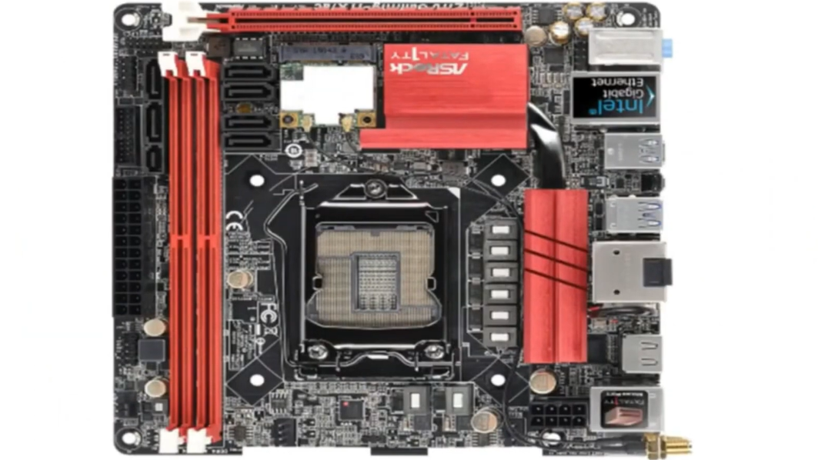
Mother Board
IN DETAIL
The motherboard is the main circuit board to which every other part is connected.
It has a CPU socket (centre), RAM slots (red, left), expansion slots for graphics and other cards (top), SATA ports for drives, and a large power connector.
Heat sinks (red) cool the chipset and power circuits.
It carries data and power between components through printed tracks called buses.
Notes:
The motherboard is the main circuit board to which every other part is connected.
It has a CPU socket (centre), RAM slots (red, left), expansion slots for graphics and other cards (top), SATA ports for drives, and a large power connector.
Heat sinks (red) cool the chipset and power circuits.
It carries data and power between components through printed tracks called buses.

Slide 5
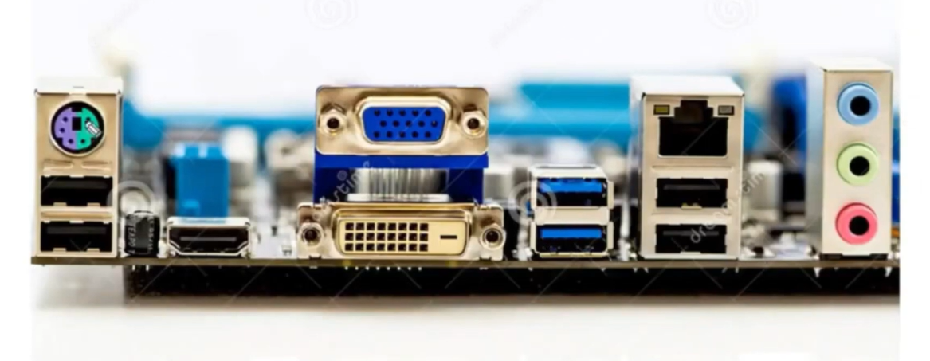
Mother Board – Back Panel Ports
IN DETAIL
The back panel is where external devices are plugged in.
PS/2 port (purple/green): old keyboard or mouse. USB ports: keyboard, mouse, pen drive, printer; blue ones are faster USB 3.0.
VGA (blue) and DVI (white) ports connect the monitor; HDMI sends video and sound.
RJ-45 LAN port: network cable. Coloured round jacks: audio – blue line-in, green speaker out, pink microphone.
Notes:
The back panel is where external devices are plugged in.
PS/2 port (purple/green): old keyboard or mouse. USB ports: keyboard, mouse, pen drive, printer; blue ones are faster USB 3.0.
VGA (blue) and DVI (white) ports connect the monitor; HDMI sends video and sound.
RJ-45 LAN port: network cable. Coloured round jacks: audio – blue line-in, green speaker out, pink microphone.

Slide 6
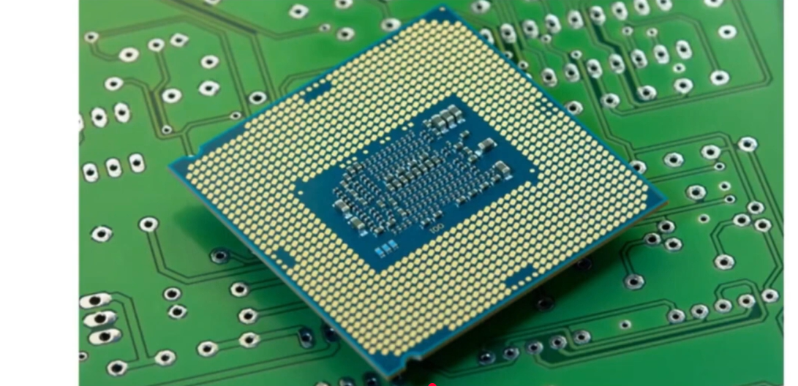
Microprocessor
IN DETAIL
The microprocessor (CPU) is the brain of the computer. It performs calculations and executes every instruction.
The underside shows hundreds of gold contact points that touch the socket on the motherboard.
Its speed is measured in GHz and its power by the number of cores. Common makers are Intel and AMD.
It becomes hot, so a heat sink and fan are always fitted on top.
Notes:
The microprocessor (CPU) is the brain of the computer. It performs calculations and executes every instruction.
The underside shows hundreds of gold contact points that touch the socket on the motherboard.
Its speed is measured in GHz and its power by the number of cores. Common makers are Intel and AMD.
It becomes hot, so a heat sink and fan are always fitted on top.

Slide 7
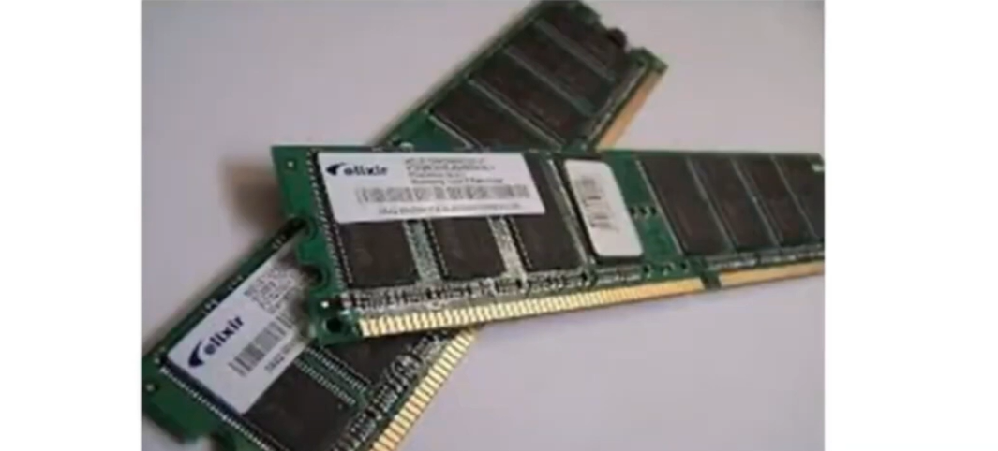
RAM
IN DETAIL
RAM (Random Access Memory) is the computer's temporary working memory.
Programs and data in use are loaded into RAM from the hard disk so the CPU can reach them quickly.
It is volatile: everything is lost when power is switched off.
The stick has a notch so it fits only in the correct slot. More RAM lets more programs run smoothly.
Notes:
RAM (Random Access Memory) is the computer's temporary working memory.
Programs and data in use are loaded into RAM from the hard disk so the CPU can reach them quickly.
It is volatile: everything is lost when power is switched off.
The stick has a notch so it fits only in the correct slot. More RAM lets more programs run smoothly.

Slide 8
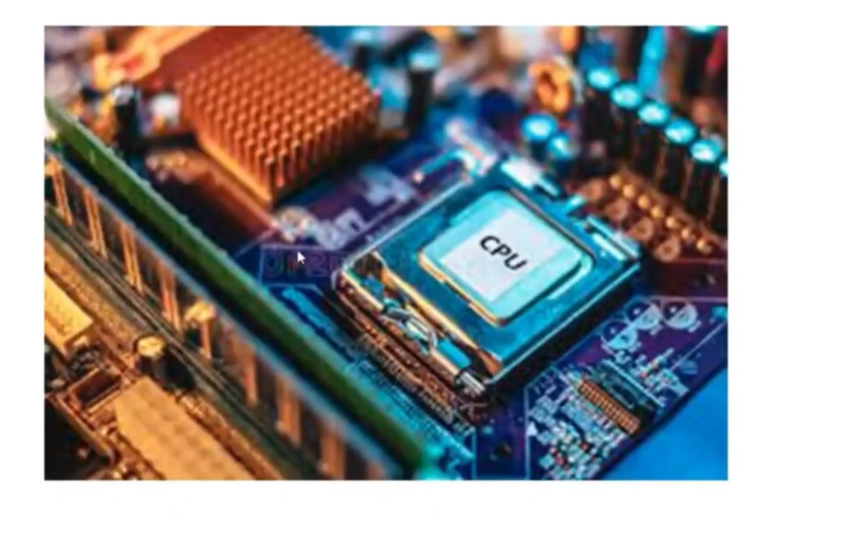
Microprocessor – CPU on the Motherboard
IN DETAIL
The CPU is fitted in the CPU socket and held down by a metal lever or clip.
A cooling heat sink with fan is placed over it with thermal paste in between.
Around it are the RAM slots and capacitors that supply stable power.
Notes:
The CPU is fitted in the CPU socket and held down by a metal lever or clip.
A cooling heat sink with fan is placed over it with thermal paste in between.
Around it are the RAM slots and capacitors that supply stable power.

Slide 9
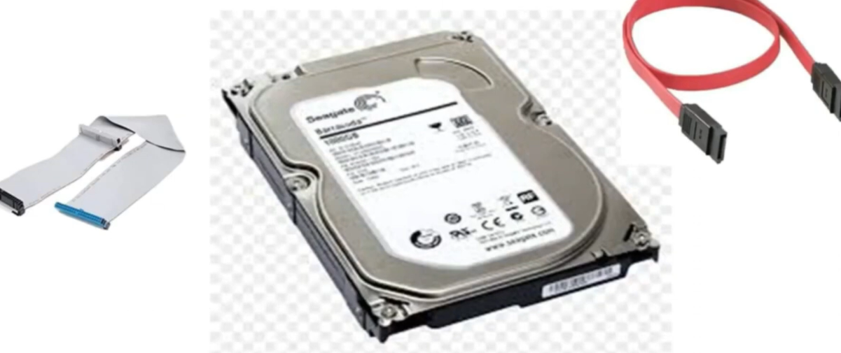
hard Disk
IN DETAIL
The hard disk is the permanent storage of the computer: Windows, software, documents, photos and videos are saved on it.
Data stays even when the computer is off.
It connects to the motherboard through a data cable – the wide grey ribbon cable (IDE) or the thin red cable (SATA) – and also needs a power cable.
Capacity is measured in GB or TB (this example is 1 TB).
Notes:
The hard disk is the permanent storage of the computer: Windows, software, documents, photos and videos are saved on it.
Data stays even when the computer is off.
It connects to the motherboard through a data cable – the wide grey ribbon cable (IDE) or the thin red cable (SATA) – and also needs a power cable.
Capacity is measured in GB or TB (this example is 1 TB).

Slide 10
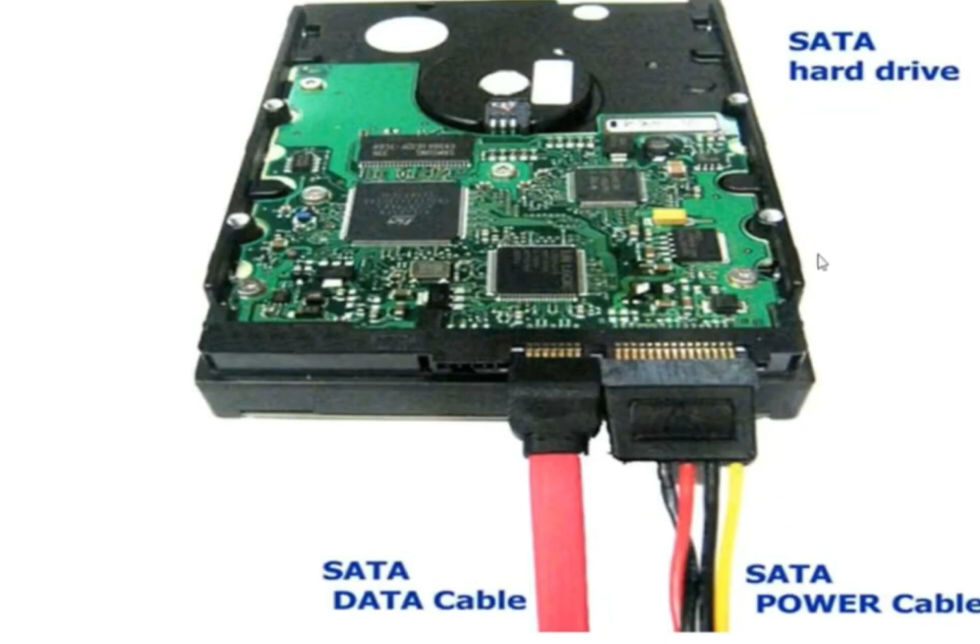
Hard Disk – SATA Data and Power Cable
IN DETAIL
SATA hard drive: the green board underneath is the controller that manages reading and writing.
SATA DATA cable (red): carries data between the disk and the motherboard.
SATA POWER cable (coloured wires): brings power from the SMPS.
Both cables must be connected for the disk to work.
Notes:
SATA hard drive: the green board underneath is the controller that manages reading and writing.
SATA DATA cable (red): carries data between the disk and the motherboard.
SATA POWER cable (coloured wires): brings power from the SMPS.
Both cables must be connected for the disk to work.

Slide 11
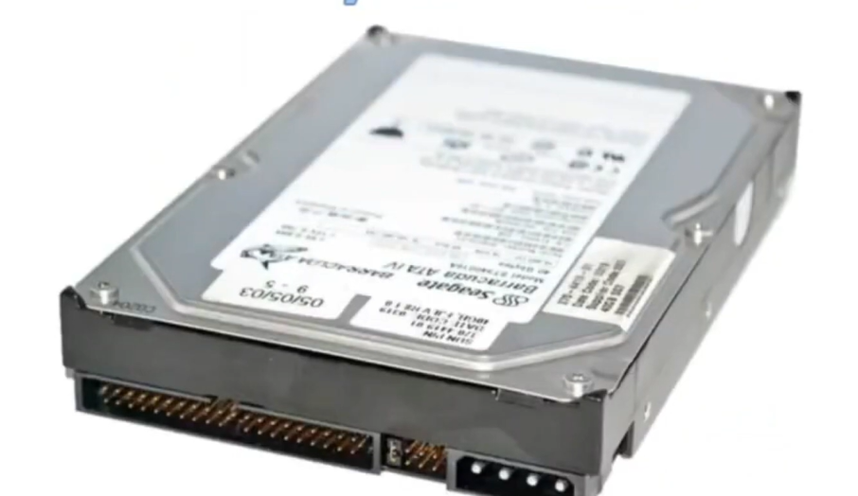
DVD/WRITER
IN DETAIL
A DVD writer reads and writes CDs and DVDs using a laser, and is used to install software, play discs and make backups.
It sits in the front 5.25-inch bay of the cabinet and, like the hard disk, needs a data cable and a power cable.
The picture on the original slide shows an older drive with an IDE (40-pin) data connector and a 4-pin Molex power socket.
Notes:
A DVD writer reads and writes CDs and DVDs using a laser, and is used to install software, play discs and make backups.
It sits in the front 5.25-inch bay of the cabinet and, like the hard disk, needs a data cable and a power cable.
The picture on the original slide shows an older drive with an IDE (40-pin) data connector and a 4-pin Molex power socket.

Slide 12
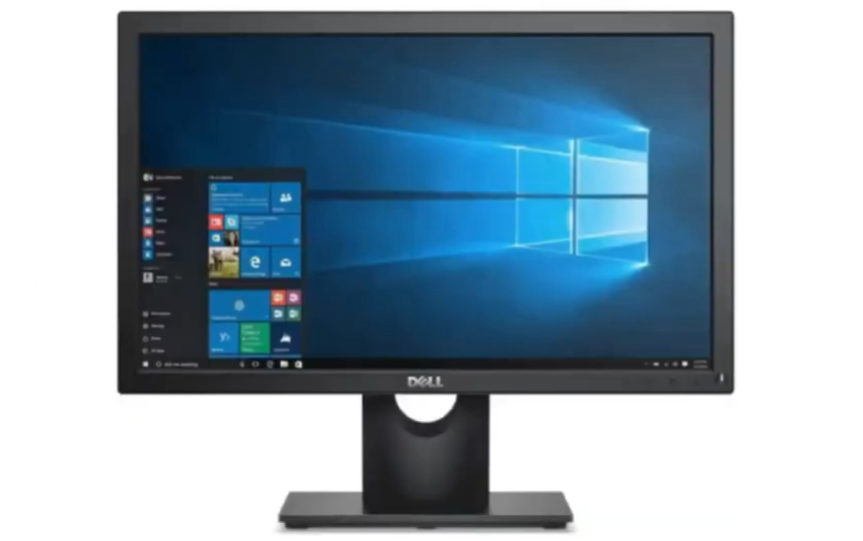
MONITOR
IN DETAIL
The monitor is the main output device; it displays text, pictures and video produced by the computer.
It connects to the computer through VGA, DVI or HDMI cable and needs its own power supply.
Screen size is measured diagonally in inches. Modern monitors are LCD/LED.
Notes:
The monitor is the main output device; it displays text, pictures and video produced by the computer.
It connects to the computer through VGA, DVI or HDMI cable and needs its own power supply.
Screen size is measured diagonally in inches. Modern monitors are LCD/LED.

Slide 13
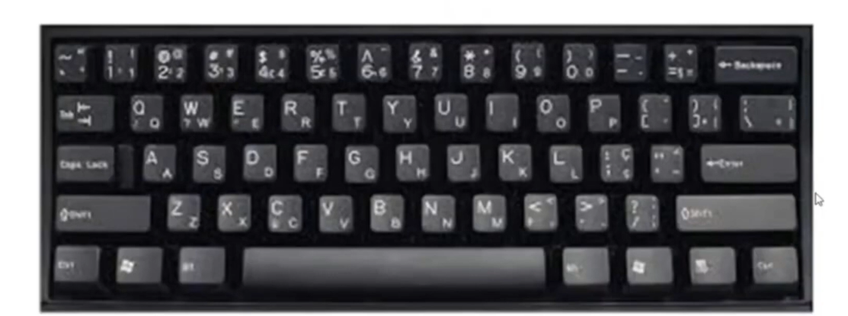
Keyboard
IN DETAIL
The keyboard is the main input device used to type text, numbers and commands.
It has alphabet keys, number keys, function keys, Shift, Ctrl, Alt, Enter, Backspace and Space Bar.
The common QWERTY layout is named after the first six letters in the top row.
It connects through a USB or PS/2 port.
Notes:
The keyboard is the main input device used to type text, numbers and commands.
It has alphabet keys, number keys, function keys, Shift, Ctrl, Alt, Enter, Backspace and Space Bar.
The common QWERTY layout is named after the first six letters in the top row.
It connects through a USB or PS/2 port.

Slide 14
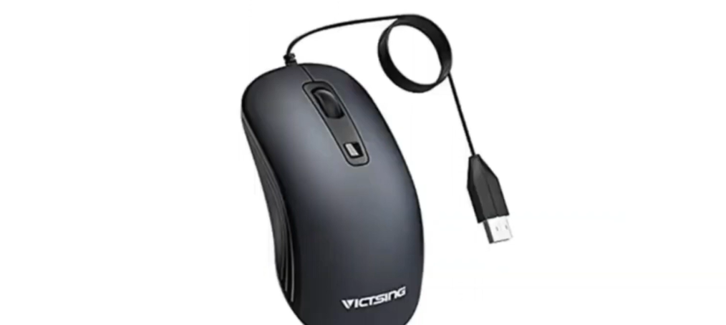
MOUSE
IN DETAIL
The mouse is a pointing input device that moves the pointer on the screen.
Left button: select and open. Right button: shortcut menu. Scroll wheel: move up and down a page.
It connects through a USB port (or wirelessly) and uses an optical sensor to detect movement.
Notes:
The mouse is a pointing input device that moves the pointer on the screen.
Left button: select and open. Right button: shortcut menu. Scroll wheel: move up and down a page.
It connects through a USB port (or wirelessly) and uses an optical sensor to detect movement.

Slide 15
Summary
Part | Type | Main job
Cabinet Box with SMPS | Internal | Holds all parts; SMPS supplies DC power
Mother Board | Internal | Connects all components
Microprocessor | Internal | Processes instructions (brain)
RAM | Internal | Temporary working memory
Hard Disk | Internal | Permanent data storage
DVD/Writer | Internal | Reads and writes discs
Monitor | Output | Displays results
Keyboard | Input | Types text and commands
Mouse | Input | Moves pointer, selects items

